Slide 1
U1 M1 L4 Gravitational Force

Slide 2
How can you change an object’s motion without touching it?
Noncontact Forces
When you drop an object, it falls toward the floor. This downward force occurs even though nothing is touching the object.
A force that one object can apply to another object without touching it is a noncontact force.
Gravity, which pulls on objects, is a noncontact force. The magnetic force, which attracts certain metals to magnets, is also a noncontact force. The electric force is another noncontact force.

Slide 5
What pulls things down?
Gravitational Force
Objects fall to the ground because Earth exerts an attractive force on them. You also exert an attractive force on objects.
Gravity is an attractive force that exists between all objects that have mass.
Mass is the amount of matter in an object. Mass is often measured in kilograms (kg).
An object does not have to be touching Earth for gravity to act on it.
The force of gravity is exerted through space as a field.
A field is a region of space that has a physical quantity (such as a force) at every point.
The gravitational field of Earth surrounds Earth at all points. Smaller objects are surrounded by smaller gravitational fields

Slide 6
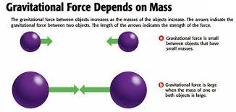
What factors affect the strength of a gravitational force?
Gravitational Force and Mass
When the mass of one or both objects increases, the gravitational force between them also increases. Each object exerts the same attraction on the other object.

Slide 7
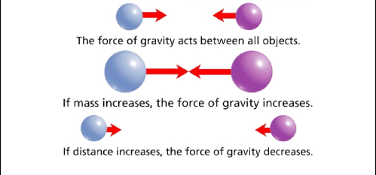
What factors affect the strength of a gravitational force?
Gravitational Force and Distance
The attraction between objects decreases as the distance between the objects increases. For example, if your mass is 45 kg, the gravitational force between you and Earth is about 440 N.
On the Moon, about 384,000 km away, the gravitational force between you and Earth would only be about 0.12 N.

Slide 8
Factors affect gravitational force
1- mass
As mass increases gravitational force increases ( direct relationship)
2- distance
As distance increases , gravitational force decreases ( inverse relationship)

Slide 9
Everything in our solar system is held in orbit by the gravitational force created by the Sun. Earth travels around the Sun due to the gravitational force between the Sun and Earth. If this force disappeared, Earth would break away from its orbit and continue traveling in a straight line into space

Slide 10
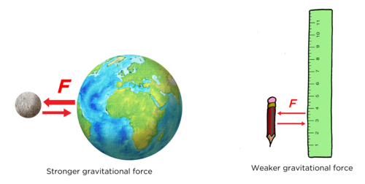
How can the force of gravity be measured?
Earth has more mass than any object near you. As a result, the gravitational force that Earth exerts on you is greater than the force exerted by any other object

Slide 11
Gravitational Acceleration
Newton’s second law of motion states that the force on an object can be found by multiplying mass by acceleration.
You can find the gravitational acceleration by dividing the force of gravity on objects by the mass of the objects.
When the only force acting on a falling object is gravity, all objects fall with the same acceleration. Near Earth’s surface, the acceleration is 9.8 m/s2 . It is called gravitational acceleration (g).

Slide 12
g is the gravitational acceleration
g on Earth = 9.8 m/s²
Which is constant ( does not change )

Slide 14
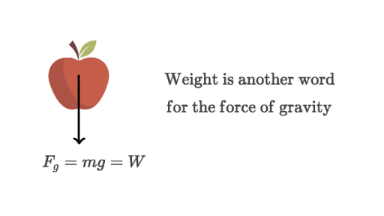
Weight
Because weight is a force, it is measured in newtons.
Weight is the gravitational force exerted on an object.
Near Earth’s surface, an object’s weight is the gravitational force exerted on the object by Earth.

Slide 15
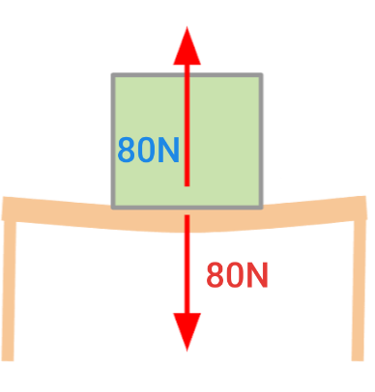
Normal Force
Newton’s third law of motion states that for every force there is an opposite equal force.
A pencil sitting on a table is acted on by gravity. This force in the downward direction is equal to its weight. Because of gravity, the pencil is pushing down on the table. The table pushes up on the pencil with an equal but opposite force.
The force of the table on the pencil is called the normal force.

Slide 16
Why are small objects not attracted to each other?
Think about what would happen if you dropped a pencil and a book you were holding at the same time. Both the book and the pencil have mass so each has its own gravitational field.
Why wouldn’t the pencil and the book attract each other? Why would both fall to the ground instead?

Slide 17
Gravity of Small Objects
All objects have mass. Therefore, all objects have a gravitational field. The masses of the pencil and the book are extremely small compared to the mass of Earth.
That means their gravitational fields are also very small compared to Earth’s gravitational field. The pencil and the book pull on each other slightly but not enough to cause a change in motion.

Slide 18
Inspire science lesson check

